Slide 1
Introduction to RTX Kernel
Mailbox

Slide 2
Mailbox
os_mbx_declare
os_mbx_init
os_mbx_send
os_mbx_wait

Slide 3
os_mbx_declare
The os_mbx_declare macro defines a mailbox object
Syntax
os_mbx_declare
(
);
Name ,
Msg_Count

Slide 4
os_mbx_init
The os_mbx_init function initializes the mailbox object
Syntax
void
os_mbx_init
(
mailbox name,
mbx_size
);

Slide 5
os_mbx_send
The os_mbx_send function puts the pointer to a message, message_ptr, in the mailbox
Syntax
OS_RESULT
os_mbx_send
(
mailbox name,
void* msg_ptr,
timeout
);

Slide 6
os_mbx_wait
The os_mbx_wait function gets a pointer to a message from the mailbox if the mailbox is not empty. The function puts the message pointer from the mailbox into the location pointed by the message argument.
Syntax
OS_RESULT
os_mbx_wait
(
mailbox name,
void** msg_ptr,
timeout
);

Slide 7
Non-interlocked, one-way data communication
System
TASK 1
TASK 2
RTOS LAB

Slide 8
Algorithm
Task1 will count 0to15 and send 15 to task2 via mailbox
Task2 will increment count value from 16 to 30 and then task1 resumes

Slide 9
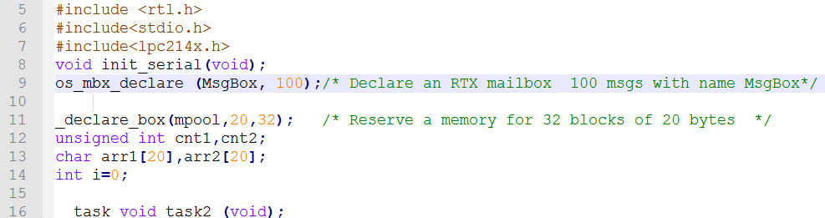

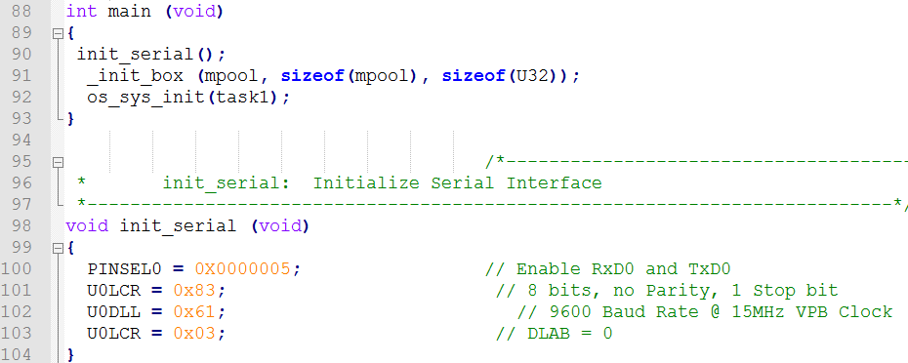

Slide 10
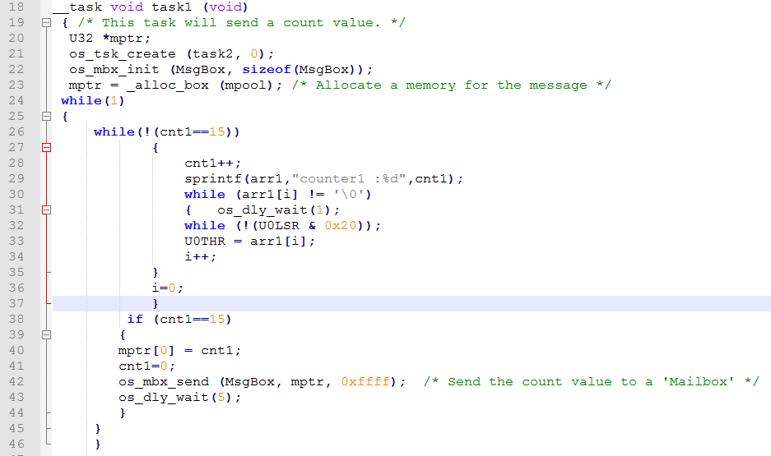

Slide 11
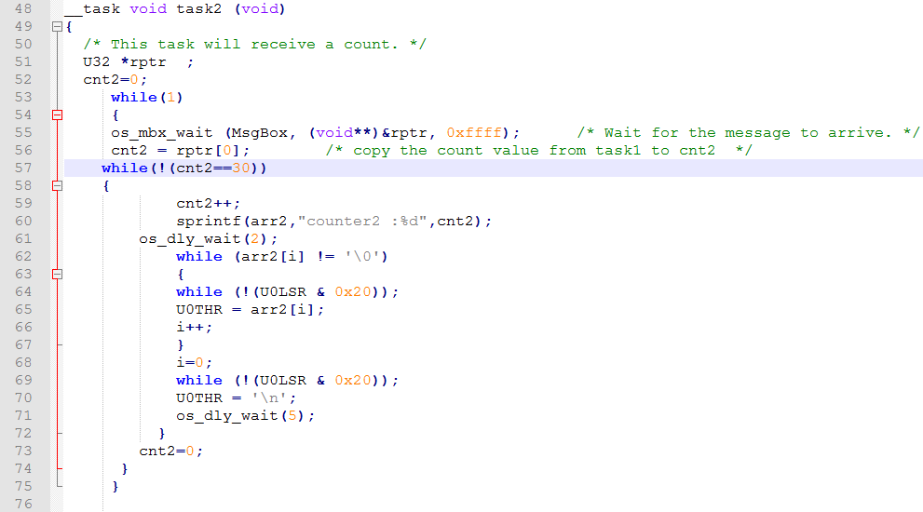

Slide 12
Thank you

